Slide 1
Regional School District #17
Provider Search Tool Overview
Open Enrollment, May 2018

Slide 2
Searching for Providers
Provider Directory

Slide 3
Oxford Provider Directory Search
1. http://www.osc.ct.gov/ctpartner/providernetworks.html
Choose “Oxford Freedom Network”

Slide 4
Oxford Provider Directory Search
2.Select your Oxford Freedom Plan
Choose “Freedom” network

Slide 5
Oxford Provider Directory Search
3. Type in your provider name
Update your location
Enter Provider Name
OR
Select type of service

Slide 6
Premium Care Providers

Slide 7
Searching for Dentists
Provider Directory

Slide 8
Oxford Provider Directory Search
1. https://www.cigna.com/sites/stateofct/index.html
Choose “Find In-Network Dentist

Slide 9
Cigna Dentist Directory Search
2. Enter Search Criteria
Enter the dentist info
Choose how far you’re willing to travel
Select type of service

Slide 10
Searching for Pharmacies
Provider Directory

Slide 11
Oxford Pharmacy Directory Search
1. http://www.osc.ct.gov/ctpartner/providernetworks.html
Choose “Maintenance Drug Network – by state”

Slide 12
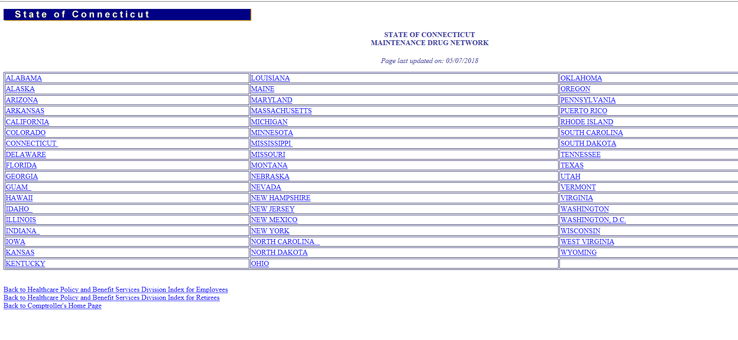
Oxford Pharmacy Directory Search
2. Select your state

Slide 13
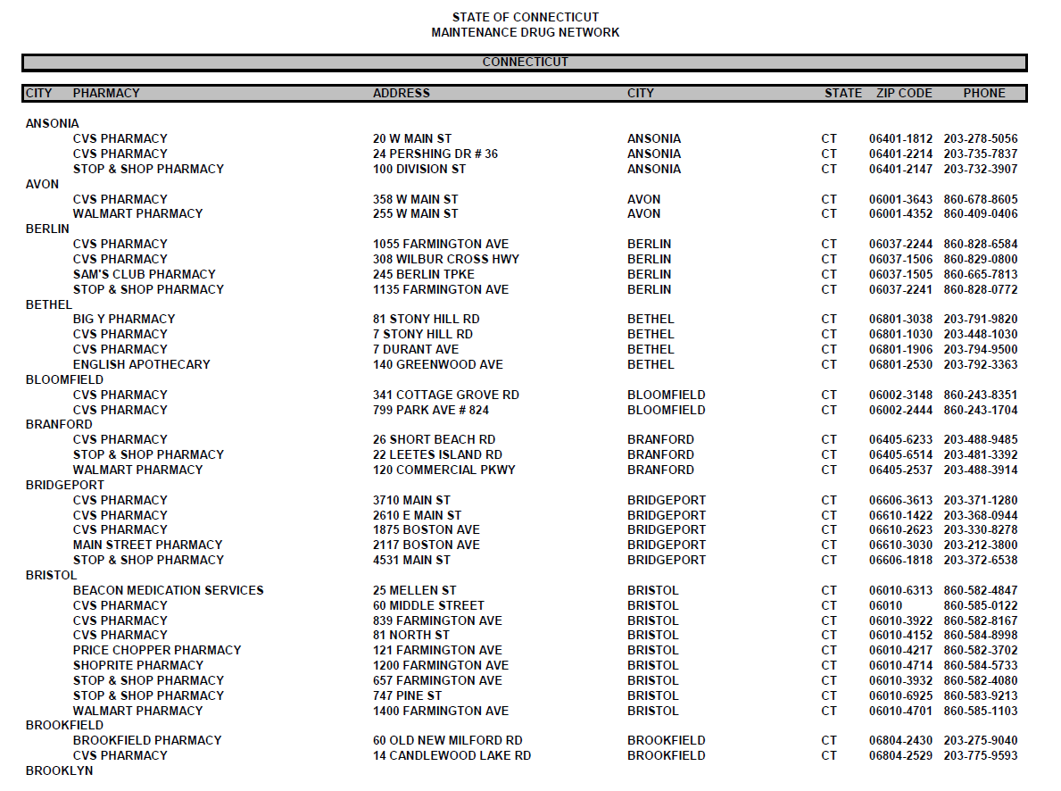
Oxford Pharmacy Directory Search
3. PDF listing of participating Pharmacies by town

Slide 14
Oxford Drug Coverage Search
1. http://www.osc.ct.gov/ctpartner/providernetworks.html
Choose “Oxford Freedom Network”

Slide 15
Oxford Pharmacy Directory Search
2. Search for Participating Pharmacies
Click “Change my Pharmacy”

Slide 16
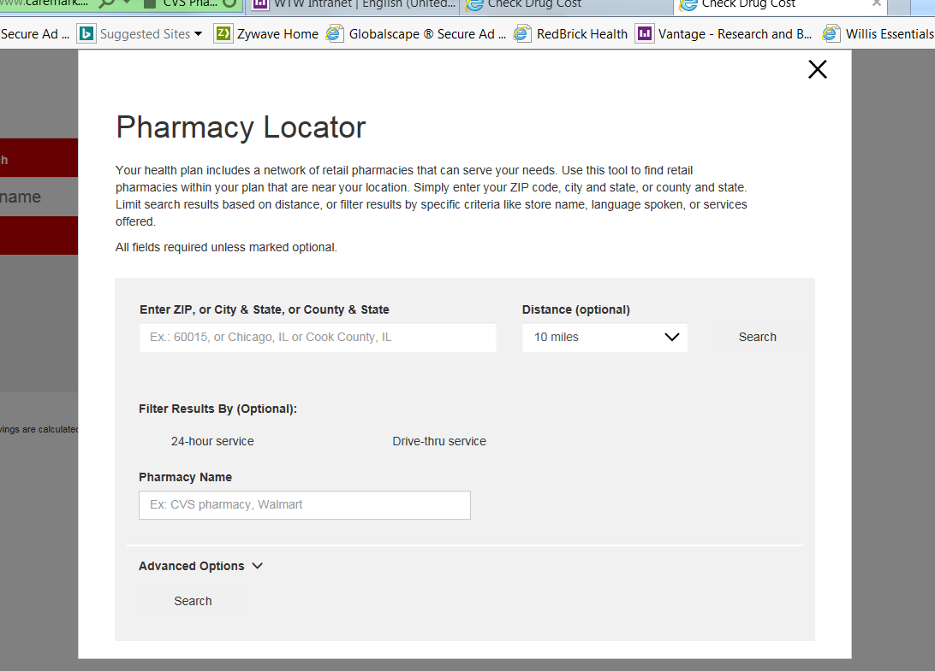
Oxford Pharmacy Directory Search
3. Update your Pharmacy
Insert appropriate Pharmacy details

Slide 17
Oxford Pharmacy Directory Search
4. Enter the name of your drug
Enter your drug name

